Slide 1


vikas
Notes:
Technology is changing fast, are you keeping up? Can't track all the latest trends?
Ansible: If you are planning to make a career in DevOps or Cloud this is one of the essential skills to have, If you don't learn you are wasting time and hurting your chances to grow.
This course is drafted by an industry expert who gives you quality and confidence @ work, I will provide you with a session full of hands-on and easy-to-follow demos, so that you can easily configure and manage remote servers.
You will learn industry best practices and learn how Ansible is integrated with Terraform & Vault.

Slide 2

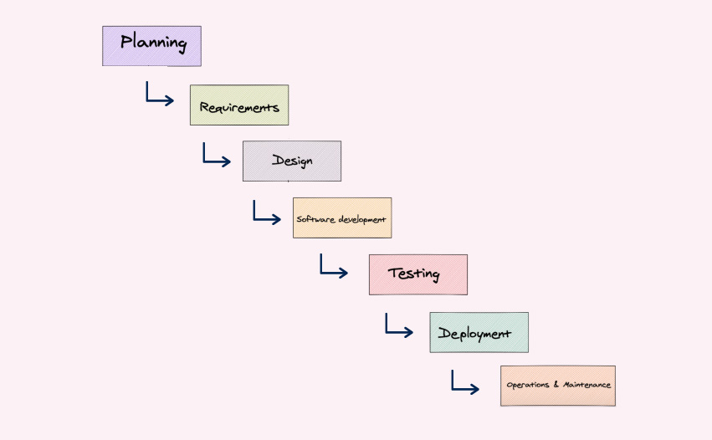



Notes:
SDLC – Software Development Phases

Slide 3
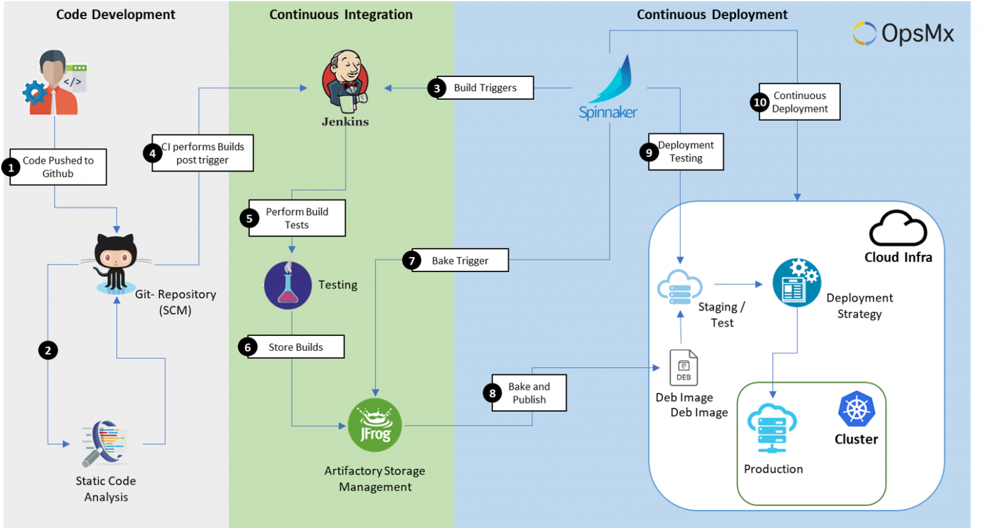
Notes:
deployment automation -- > movement of code (tested) from dev --> production
Steps involved to deploy code changes:
Remove the load balancer & auto-scaling.
Remove monitoring of servers.
Stop the servers.
deploy your change & sanity check
Restart the servers
6 min * 100 ==600mins = 10 hrs. ==> shell script ==> complex ==100 scripts
1 single ansible script[YAML] = 10 mins ===> saving time (speed)
===> Automating the process (Efficiency) ===> Human intervention (Reduced Risk)

Slide 4
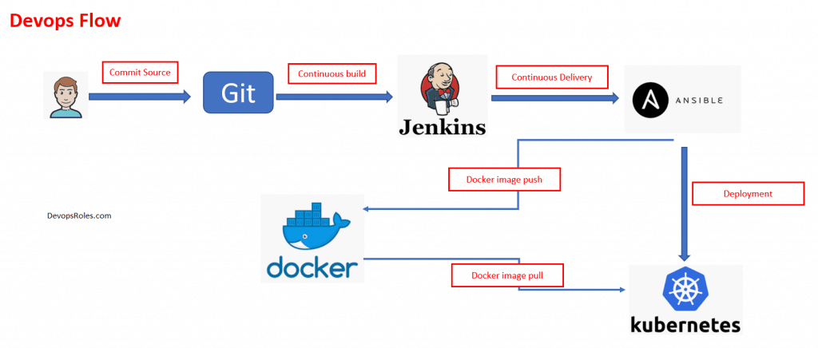

Slide 5
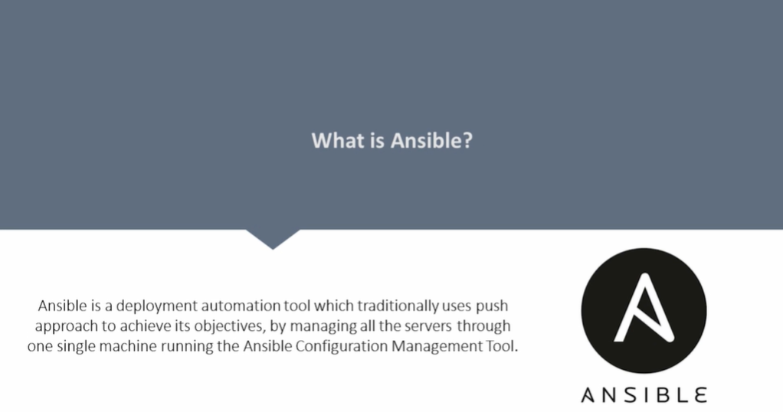
Notes:
Ansible is a simple IT automation platform that makes your applications and systems easier to deploy.
Ansible was originally written by Michael DeHaan .Developers ease into using Ansible because it is built on Python.
Ansible is open-source, easy to learn, simple, agentless, and has idempotent behavior.
It runs on many Unix-like systems and can configure both Unix-like systems as well as Microsoft Windows.

Slide 6
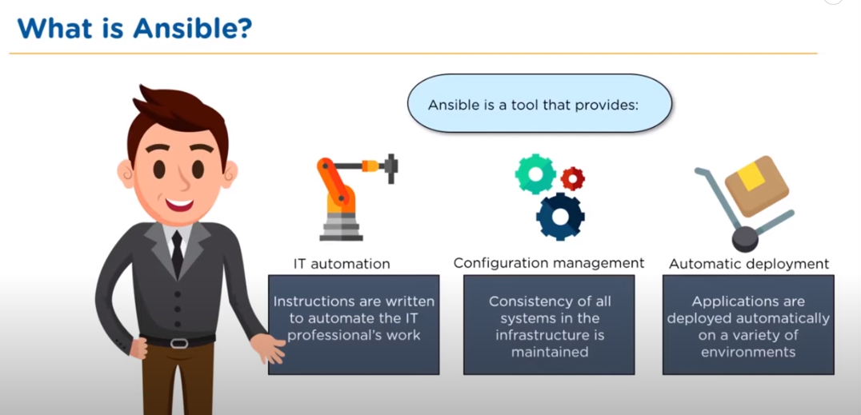
Notes:
Ansible can help you with provisioning and configuration management, application deployment & task automation as shown below:
Configuration of servers – like installing a particular application on 100 machines. Just write the playbook and automate the stuff.
Application deployment – Number of steps to be followed to deploy an application.
Implementation of Infrastructure
Compatible with any platform
Secure and scalable

Slide 7
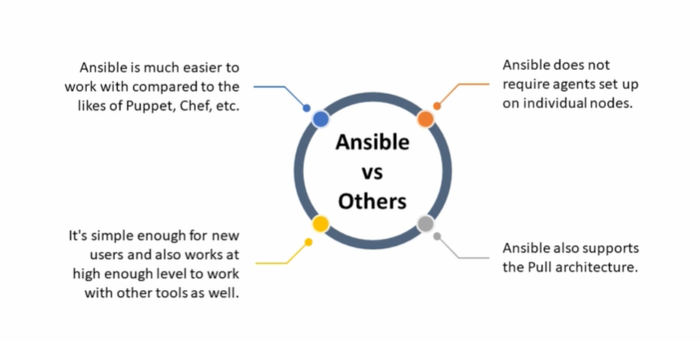
Notes:
Automate – Deploy apps
- Manage servers
- Ease complexity
Accelerate – Solve once and use it many times.
Collaborate & integrate with automation

Slide 8
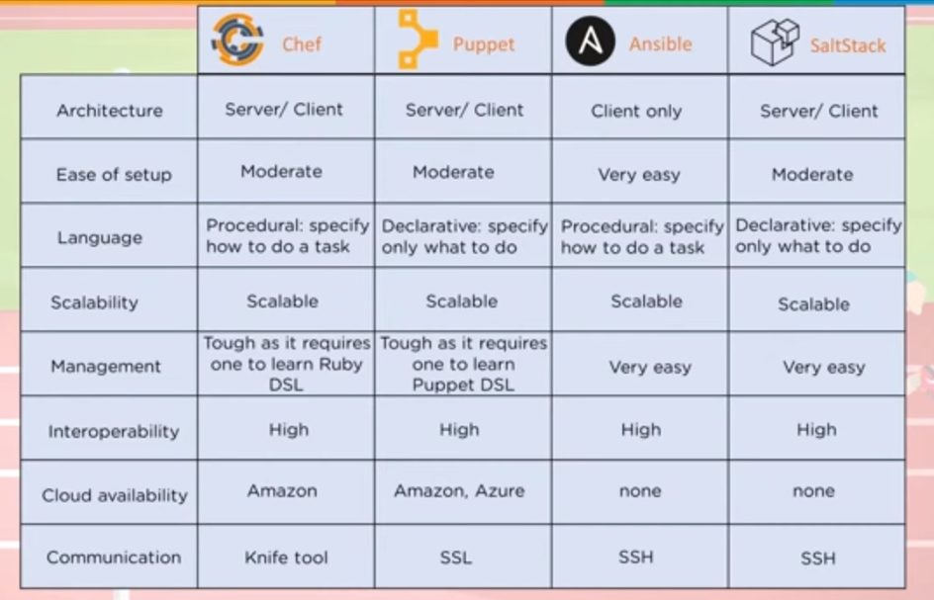
Notes:
# Complex Ansible Playbook:
============================
- Deploy 50 VMs on public/private cloud
- provision additional storage to all VM
- Setup cluster configuration
- Setup network configuration on Private VMs
- Configure Web Server on 20 Public VMs
- Configure DB server on 20 private VM
- setup monitoring components
- Install & configure backup clients on VM
- Setup Load balancing & auto scaling between web servers

Slide 9
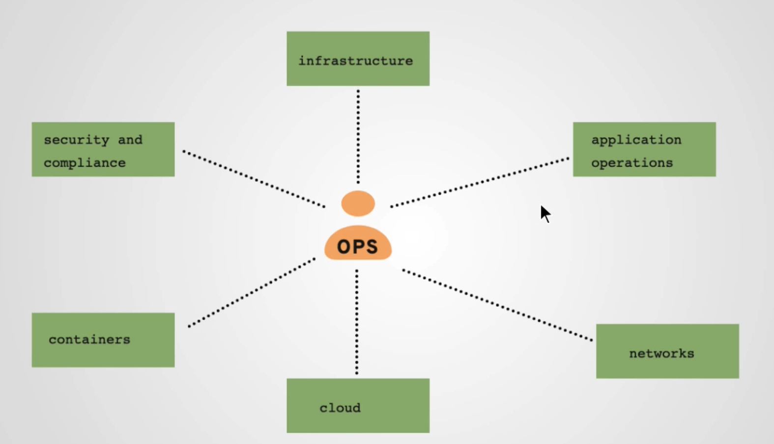
Notes:
Think How will you install the software in 1 Server – Write a script or do it manually but how will you do it when it comes to 1000 servers that too it’s a daily task.
Consider a system admin who is managing 1000 Linux servers. So, post configuration part after server build, software patching, and application deployment is done regularly and manually.
Let’s assume there is a vulnerability related to SSH & you have to figure out what is the version on each server.
Stop Monitoring
Log to each server – Manually
Remove instances from Load Balancer & Autoscaling
Stop the services running
Deploy Application
Check the Service status

Slide 10
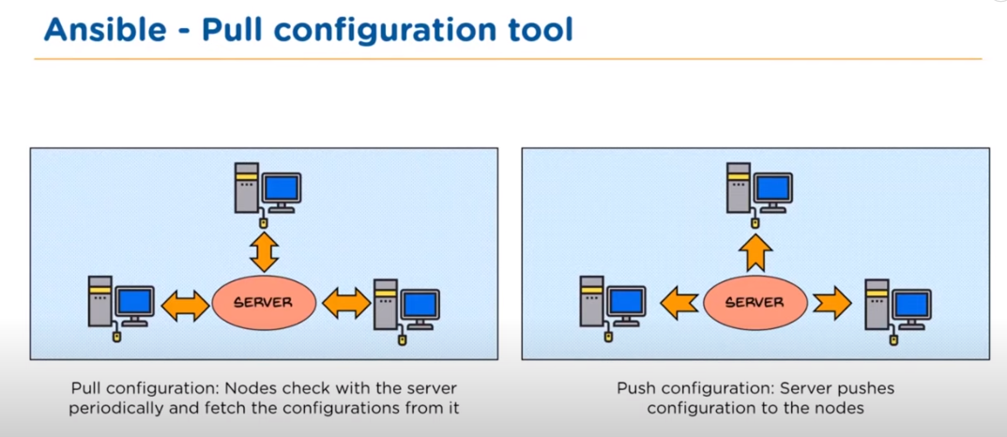
Notes:
Push:
Doesn't require any agents to be installed on individual servers like pull.
Changes are synchronous and changes can be implemented instantly . So, in case of failures revert is easy.
Pull:
Works good with master-slave architecture where agents are needed on slave nodes.
Scaling of worker nodes is easy. Hence used for Infrastructure upgradation .

Slide 11
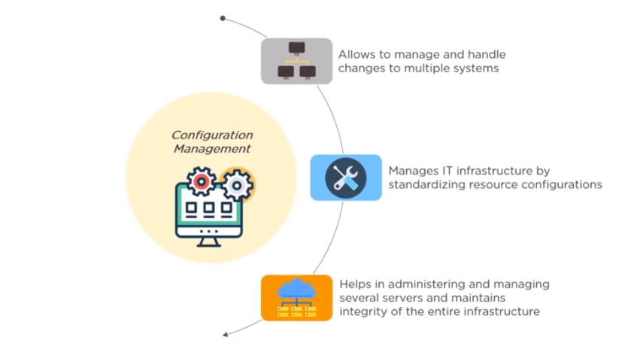
Notes:
Ansible is a software provisioning, configuration management, and application-deployment tool.
Configuration management is the practice of handling changes systematically so that a system maintains integrity over time.
Configuration management ensures that the current design and build state of the system is known, good & trusted.
It doesn't rely on the tacit knowledge of the development team

Slide 12
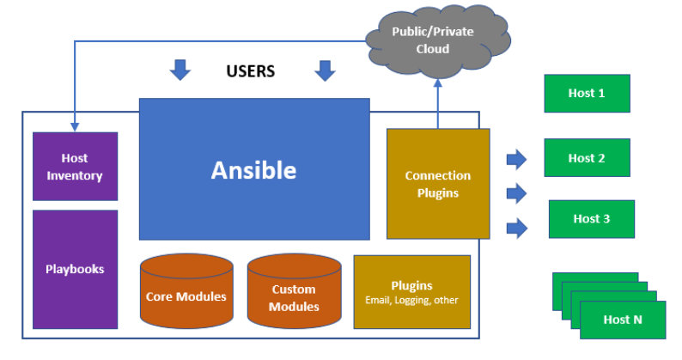
Notes:
Ansible playbooks – An organized unit of scripts that defines the work of server configuration and is written in YAML. Instead of writing custom, individualized scripts, system administrators create high-level plays in Ansible. A play performs a series of tasks on the host, or group of hosts, specified in the play. A file that contains one or more plays is called a playbook.
A managed host is a system that Ansible logs into, installs modules, and executes remote commands to perform configuration tasks. Other names for a managed host include managed node and remote node.
Ansible uses SSH to communicate with managed hosts, so SSH must be installed and configured to allow incoming connections. Managed hosts must have Python 2.4 or later installed to run Ansible, which includes Red Hat Enterprise Linux 5, 6, and 7 hosts.
The python-simple json package must also be installed on Red Hat Enterprise Linux 5 managed hosts. It is not required on Red Hat Enterprise Linux 6 and 7 managed hosts, since Python 2.5 (and newer versions) provide its functionality by default.
Host Inventory defines which hosts Ansible manages. Hosts may belong to groups that are typically used to identify the hosts' role in the data center. A host can be a member of more than one group.
Limitations :
Ansible can add packages to an installation, but it does not perform the initial installation of the system. Every system can start with a minimal installation, either via Kickstart or a base cloud starter image, then use Ansible for further configuration.
Although Ansible can remediate configuration drift, it does not monitor for it.
Ansible does not track what changes are made to files on the system, nor does it track what user or process made those changes.

Slide 13
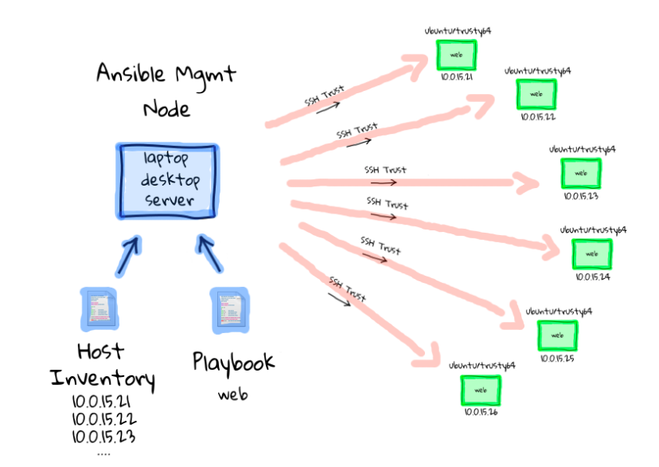
Notes:
System administrators log in and initiate all Ansible operations from the control node. Ansible software is installed on the control node. Ansible configuration files are also maintained on the control node.
A machine acting as a control node must have Python 2.6 or 2.7 installed. This includes Linux, OS/X, and any BSD based Unix system. Windows is not supported for the control node at this time.
Ansible Engine/ Controller / Master -- -- > SSH -- > Ansible Nodes/ Clients

Slide 14
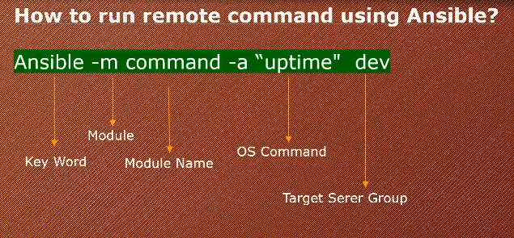
Notes:
https://github.com/vikas99341/Ansible-master-class/blob/main/Adhoc-commands
ansible app -s -m group -a "name=admin state=present"
ansible app -s -m user -a "name=devops group=admin createhome=yes"

Slide 15
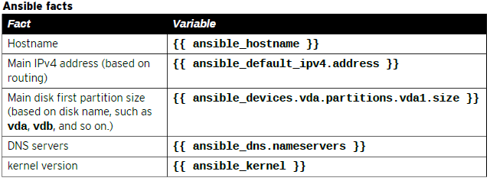
Notes:
Ansible facts are variables that are automatically discovered by Ansible from a managed host.
ansible <web-server> -m setup -a “filter=hostname”

Slide 16
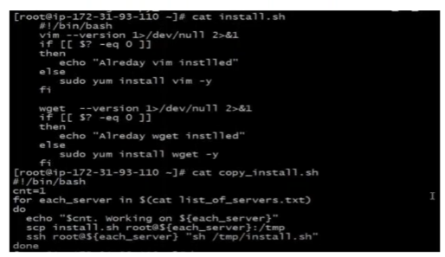
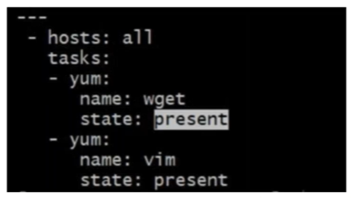
Notes:
Shell vs YAML

Slide 17
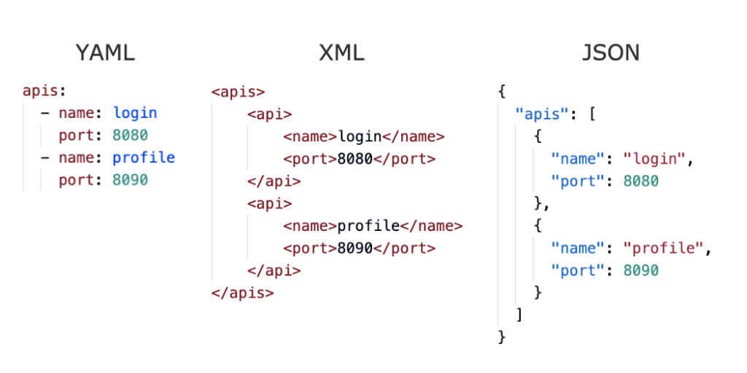

Slide 18
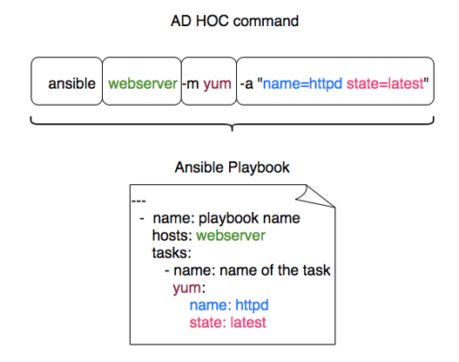
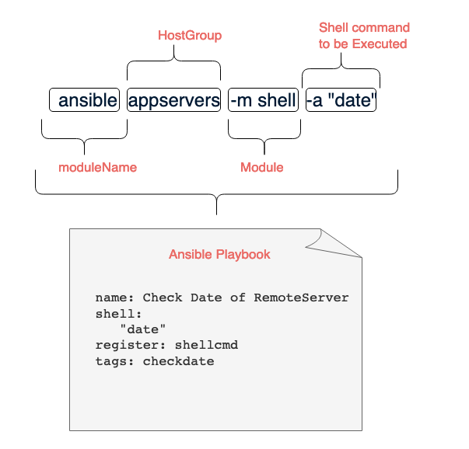

Slide 19
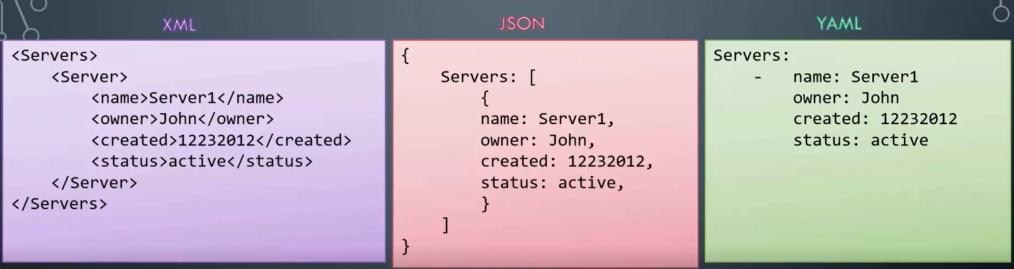
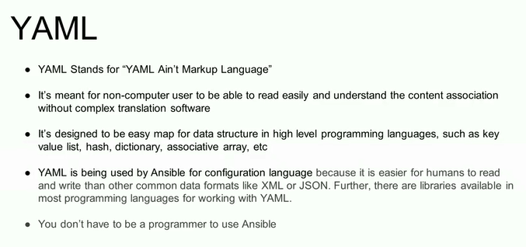
Notes:
sudo ls / and sudo ls /root/ will let you know if the new user added is a sudo user now .
sudo chown –R ansible. /etc/ansible
to check if a software mysql is installed : rpm –qa | grep mysql
If you are not able to push image : use docker login command to connect to hub
If you get missing sudo password error : visudo at home directory add at the end ansadmin ALL=(ALL) NOPASSWD: ALL
Make sure /opt/docker is owned by ansadmin
---
- hosts: all
become: true
tasks:
- name: stop running container
command: docker stop simple-devops-container
ignore_errors: yes
- name: remove stopped container
command: docker rm simple-devops-container
ignore_errors: yes
- name: remove docker image
command: docker rmi simple-devops-image
ignore_errors: yes
- name: building docker image
command: docker build -t simple-devops-image .
args:
chdir: /opt/docker
- name: creating docker image using docker command
command: docker run -d --name simple-devops-container -p 8080:8080 simple-devops-image

Slide 20
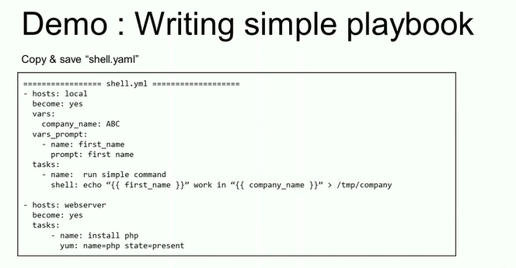
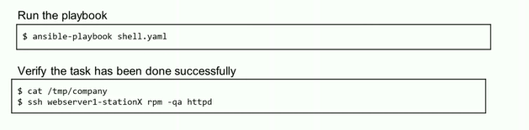
Notes:
Modules are highlighted above
Now in ansible machine as ansadmin @ /opt/docker create :
Dockerfile
# Pull tomcat latest image from dockerhub
From tomcat:8.0.22
# Maintainer
MAINTAINER Vikas
# copy war file on to container
COPY ./webapp.war /usr/local/tomcat/webapps
2. simple-devops-image.yml
---
- hosts: all
become: true
tasks:
- name: building docker image
command: docker build -t simple-devops-image .
args:
chdir: /opt/docker
3. Create a hosts file here also:
vi hosts add local host
ansible-playbook -i hosts simple-devops-image.yml --check
ansible-playbook -i hosts simple-devops-image.yml
4. Add
---
- hosts: all
become: true
tasks:
- name: building docker image
command: docker build -t simple-devops-image .
args:
chdir: /opt/docker
- name: create container using simple-devops-image
command: docker run -d --name simple-devops-container -p 8080:8080 simple-devops-image
check and validate :
Run docker login and service docker start
Make sur that you have added ansadmin ti visudo file .
Make sure /opt/docker directory is owned by ansadmin
Enable sshd_config
Practice

Slide 21
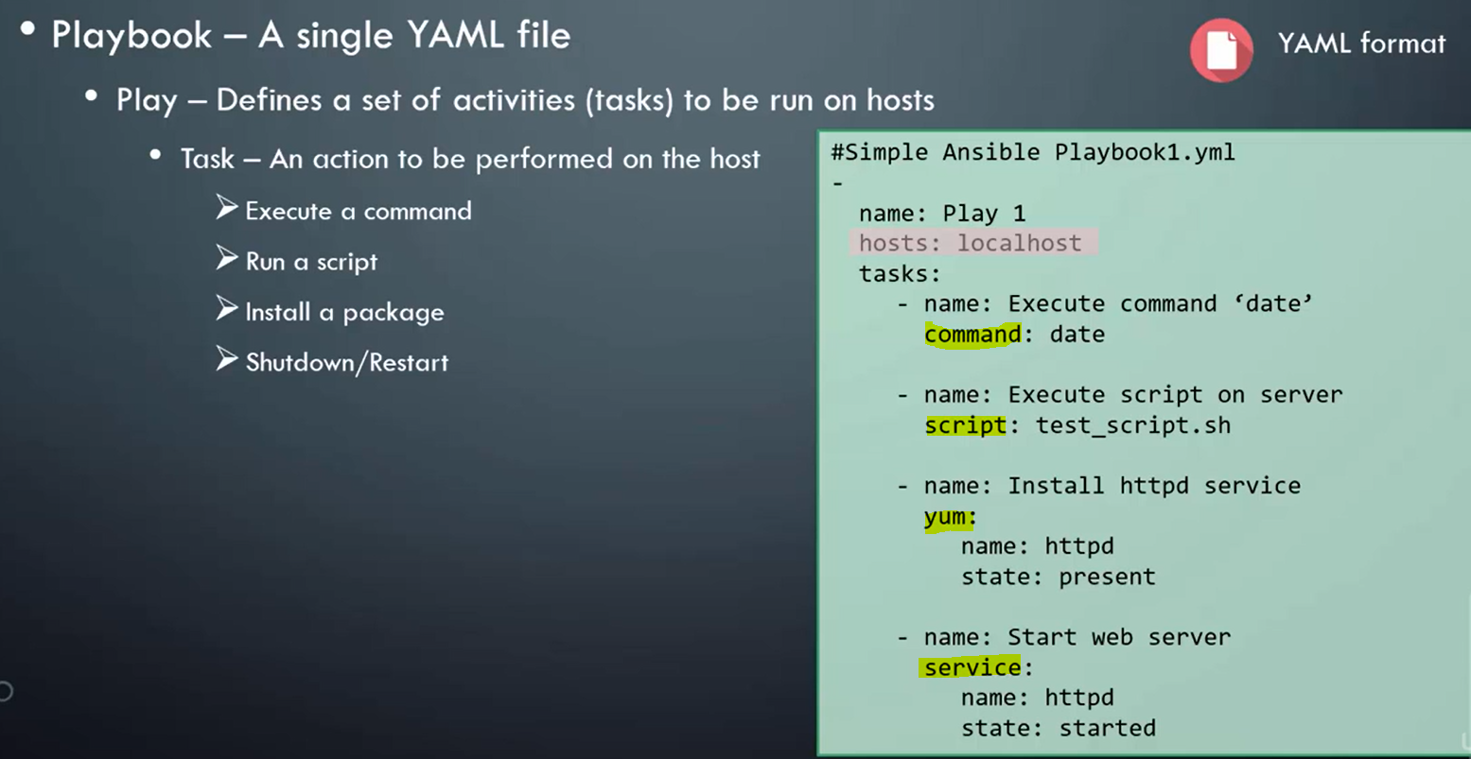
Notes:
Run the same from Jenkins
ansible-playbook -i /opt/docker/hosts /opt/docker/simple-devops-image.yml ;
Create a better ansible playbook simple-dev-ops-project.yml
---
- hosts: all
become: true
tasks:
- name: stop current running container
command: docker stop simple-devops-container
ignore_error: yes
- name: remove the stopped container
command: docker rm simple-devops-container
ignore_error: yes
- name: remove the docker image
command: docker rm simple-devops-image
ignore_error: yes
- name: building docker image
command: docker build -t simple-devops-image .
args:
chdir: /opt/docker
- name: create container using simple-devops-image
command: docker run -d --name simple-devops-container -p 8080:8080 simple-devops-image

Slide 22
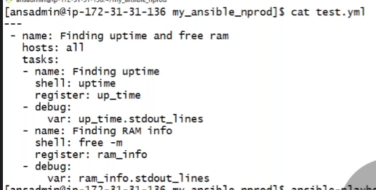

Slide 23
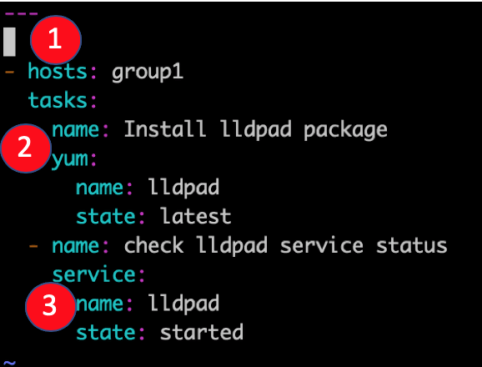
Notes:
Playbooks are the files where Ansible code is written. Playbooks are written in YAML format. Playbooks are one of the core features of Ansible and tell Ansible what to execute.
Ansible uses YAML syntax for expressing Ansible playbooks because it is very easy for humans to understand, read and write than other common data formats like XML or JSON.
Each playbook is an aggregation of one or more plays in it. Playbooks are structured using plays. There can be more than one play inside a playbook.
===============================================================
---
- hosts: dev
become: true
become_user: root
tasks:
- name: run the script
script: /home/sverma/ansible/scr.sh
when: ansible_distribution == "RedHat" and ansible_distribution_major_version == '7’
===============================================================

Slide 24
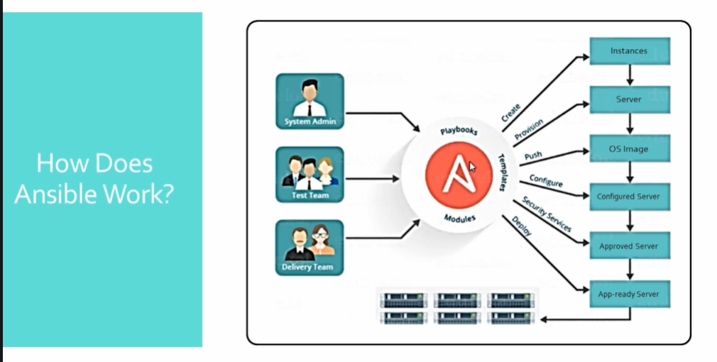
Notes:
Roles are instant rules available on Ansible galaxy .
Playbooks can be transformed into roles which are more effective and reusable.
mkdir files handlers meta tasks vars
sudo ansible-galaxy install --roles-path /etc/ansible/roles geerlingguy

Slide 25
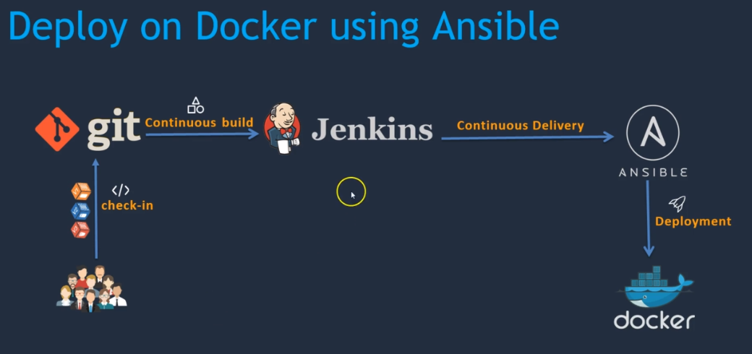
Notes:
yum install python python-pip –y
pip install ansible or sudo amazon-linux-extras install ansible2
ansible --version
python --version
mkdir /etc/ansible
useradd ansadmin
passwd ansadmin
visudo
shift + G -- > end of file
ansadmin ALL(ALL) NOPASSWD: ALL -- > Will not always ask for password now
install docker here in this machine too -- > yum install docker
service docker start
add ansadmin to Docker group -- > usermod –aG docker ansadmin
vi /etc/ssh/sshd_config -- > password authentication yes -- > service sshd reload
su ansadmin -- > ssh-keygen -- > ssh-copy-id ansadmin@<pvt-ip of docker machine> and → ssh-copy-id localhost-- check ssh ansadmin@<pvt-ip of docker machine> -- exit
now as ansadmin only -- > cd /etc/ansible -- > sudo vi hosts -- > add pvt ip of docker and local host
check == > ansible –m ping
Same set of activity must be done on docker machine – starting from creating ansadmin user

Slide 26
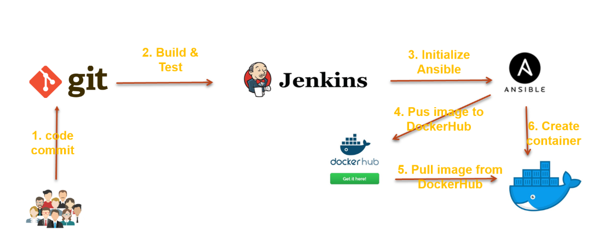
Notes:
docker tag simple-devops-image vikas24775/vikas-cicd-image
docker push vikas24775/vikas-cicd-image
docker pull vikas24775/vikas-cicd-image
vi create-simple-devops-image.yml
---
- hosts: all
become: true
tasks:
- name: create docker image using war file
command: docker build -t simple-devops-image:latest .
args:
chdir: /opt/docker
- name: create tag to image
command: docker tag simple-devops-image vikas24775/vikas-cicd
- name: push image to docker hub
command: docker push vikas24775/vikas-cicd
- name: Remove docker image from ansible server
command: docker rmi simple-devops-image:latest vikas24775/vikas-cicd
ignore_errors: yes
cp simple-devops-project.yml create-simple-devops-project.yml
create-simple-devops-project.yml
======================
---
- hosts: all
become: true
tasks:
- name: stop current running container
command: docker stop simple-devops-container
ignore_errors: yes
- name: remove the stopped container
command: docker rm simple-devops-container
ignore_errors: yes
- name: remove the docker image
command: docker rmi vikas24775/simple-devops-image:latest
ignore_errors: yes
- name: pull docker image
command: docker pull vikas24775/simple-devops-image:latest
- name: create container using simple-devops-image
command: docker run -d --name simple-devops-container -p 8080:8080 vikas24775/simple-devops-image:latest

Slide 27
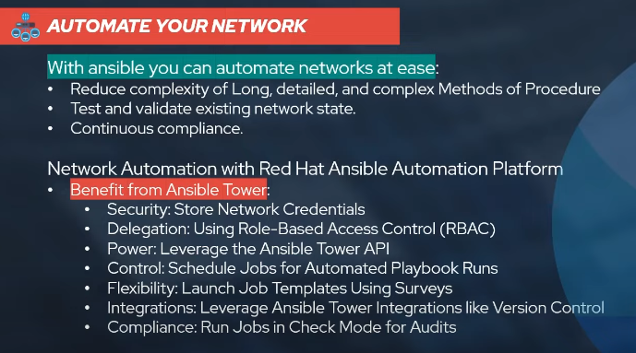

Slide 28
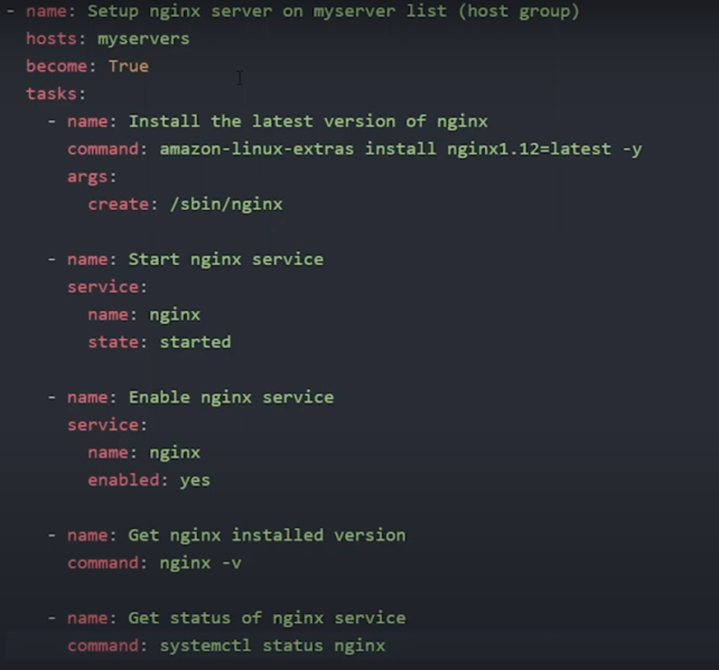

Slide 29
